Slide 1

SHARAD INSTITUTE OF TECHNOLOGY, POLYTECHNIC, YADRAV.
Shri Shamrao Patil (Yadravkar) Educational & Charitable Trust’s
Welcome…
COMPUTER ENGINEERING
DEPARTMENT

Slide 2

AGROGUIDE PEST DETECTION USING IMAGE PROCESSING
Presented by-
Name Of Student | Roll No.
1. Pranav Pramod Charate | 13447
2. Shreyash Santosh Gaikwad | 13449
3. Siddhant Lagamanna Keste | 13453
4. Aditya Vijay Mali | 13454
Under the Guidance of, Mrs. P. R. Chougule

Slide 3

Introduction
🠶 The current agriculture field is not proficient enough as the farmers have to face a lot of problems like survey the land manually for pest detection.
🠶 Usually the old methods trap the insect pests and are brought to the laboratory for
counting and identifying manually.
🠶 This ultimately leads to financial loss of farmers and reduction in productivity.

Slide 4
Choice of topic with reasoning
🠶 So to tackle this problem, image analysis and processing can provide a realistic
opportunity for the automation of insect pest detection.
🠶 Using an automated system, farmers can easily count the pests from the collected specimens.
🠶 Right pests management can be applied to increase both the quantity and quality of production.
🠶 Hence, we decided to create a farmers’ friendly Pest Detection application.

Slide 5
Relevant Literature Review
🠶 Early Pest Detection from Crop using Image Processing and Computational Intelligence by Danish Gondal and Yasir Naiz, their paper proposed a framework for early detection of pests.
🠶 Reference- https://www.researchgate.net/publication/282119578_Early_Pest_Detection_from_Crop_using_I mage_Processing_and_Computational_Intelligence
🠶 e-Sagu: An IT based Personalized Agro-Advisory System- This system provided the farmers with the mobile phones to take the pictures of their crops themselves and then it goes to the nearest e- sagu center for the report generation which is again a tedious task to do.
🠶 Reference-https://youtu.be/YFvGvr3vzIw

Slide 6
Proposed System
To overcome the problems mentioned in previous points we have proposed the following system as a solution:
Loading image of damaged crop in the application memory which will be captured from farmer’s smart phone.
Image pre-processing.
Detection of pest in the image.
Extraction of the detected pest.
Displaing results in the farmer’s smart phone.

Slide 7
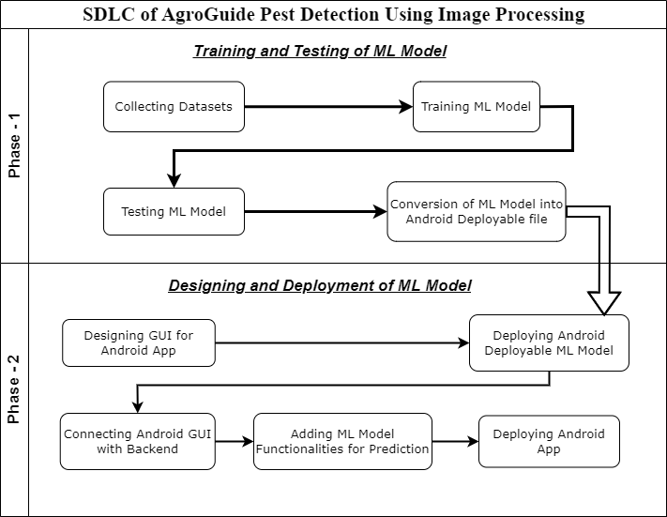

Slide 8
Methodology
🠶 Methods of Data Collection
Interviews
Observations
Documents and records
News
🠶 Processes used for ML Model creation
Training and Testing of ML Model
🠶 Designing application and Deploying ML model
Create Android UI
Run your UI using AVD
Deploying ML Model on Android App
Write backend logic in java

Slide 9
Modules (Features)
Weather –
We are using “OpenWeathermap’s” Current weather API for access current weather data.
The API provides information on temperature, precipitation and other related weather observations elements as well as date /time, weather icon codes and phrases.
News –
We are using “NewsAPI’s” for searching and retriving news from all over the web.
News API is a simple, easy to use REST API that returns JSON search results for current and historic news articles published by over 80000 worldwide sources.

Slide 10
Daily Market price –
We use Open Government Data Platform of India’s Dialy Prices of commondities from markets various API.
According to various state the daily vegetable prices are continually change. In various places there are various product price so it is important to understand farmer what is the market rate of his product so that he get high cost for his product and he not cheated from brokers. So that reasone we develop daily market price feature in our application. Which shows daily market prise of product of various state. It is most important which make farmer economically stronger

Slide 11
To do list –
To-do lists offer a way to increase productivity, stopping you from forgetting things, helps prioritise tasks, manage tasks effectively, use time wisely and improve time management as well as workflow. With the help of this farmer can mange his daily work properly and also he complect his task within a time.
Fertilizer calculator –
Fertilizers provide crops with essential nutrients like nitrogen, so that the crops grow bigger, faster, and produce more food. But high amount of fertilizer damage the crops so it is necessary to give right amount of fertilizer to the crop. And farmer can not predict what amount of fertilizer they need to their farm. By understanding this problem we make fertilizer calculator so that shows what amount of fertilizer need to the farm by simply giving input as farm area.

Slide 12
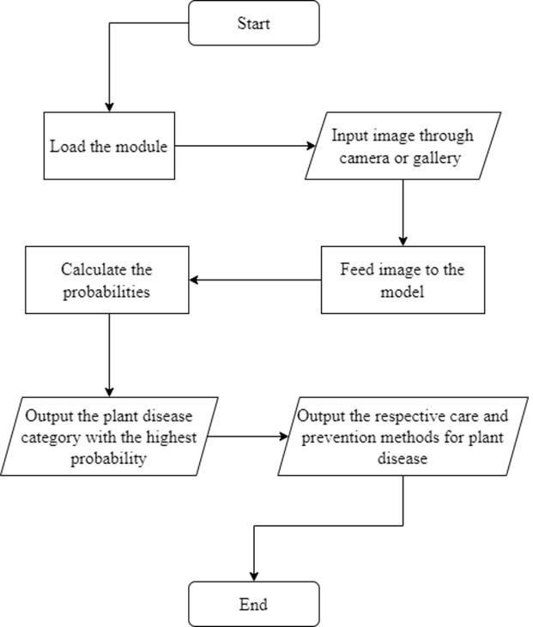
Application Flow Diagram

Slide 13
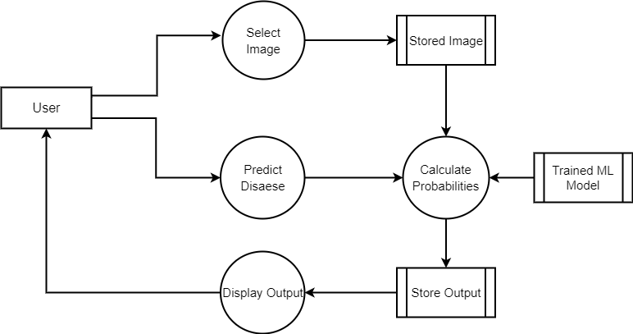
Application Data Flow Diagram

Slide 14
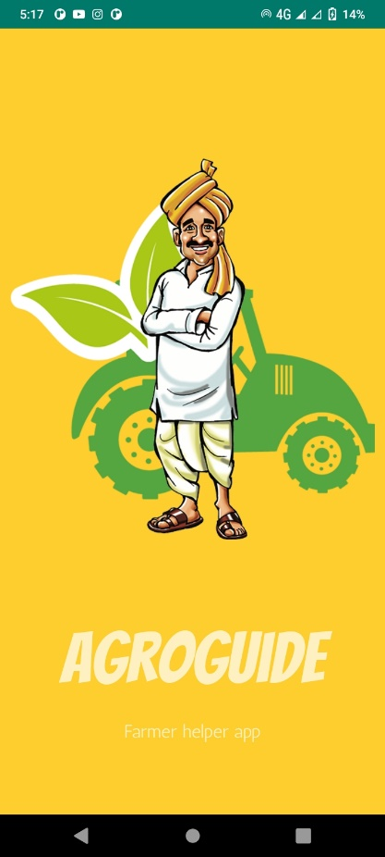
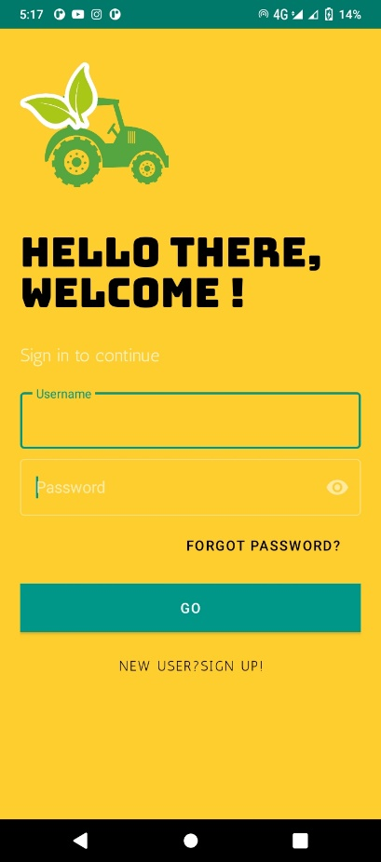
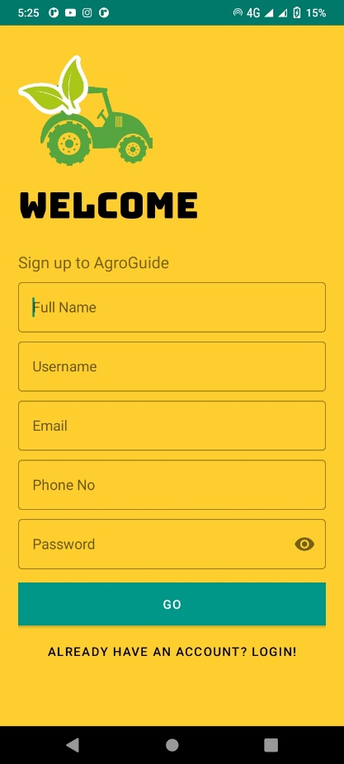
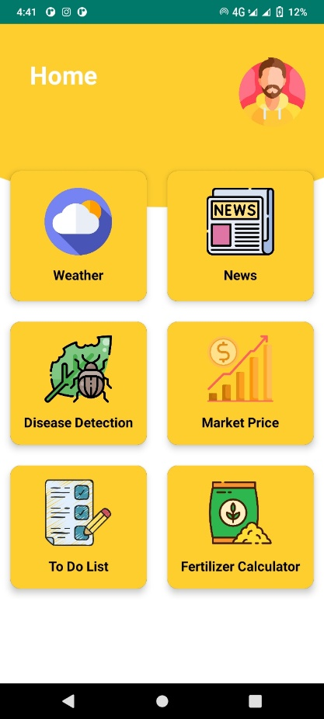
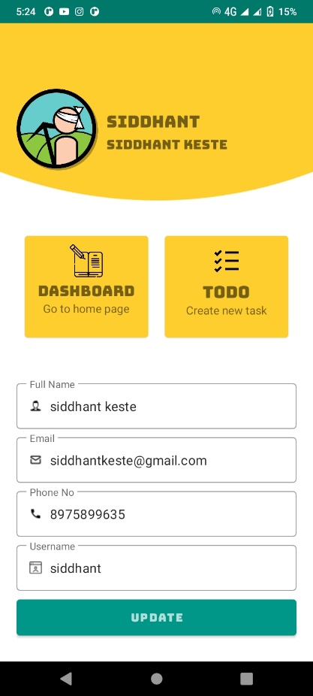
Application Output

Slide 15
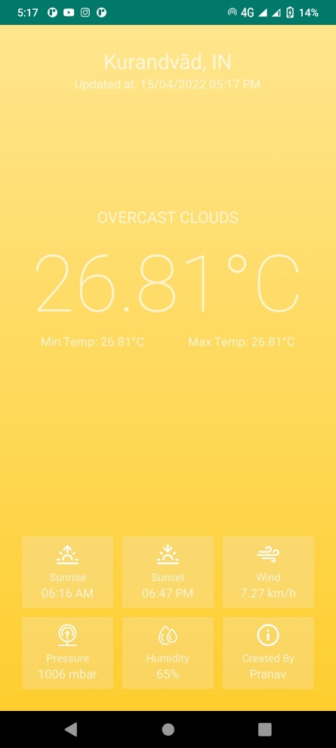
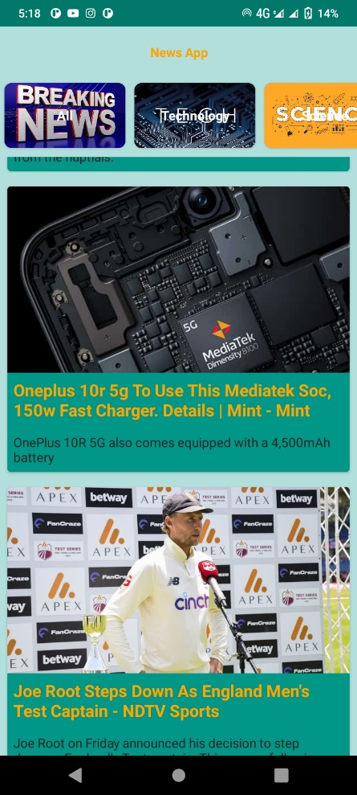
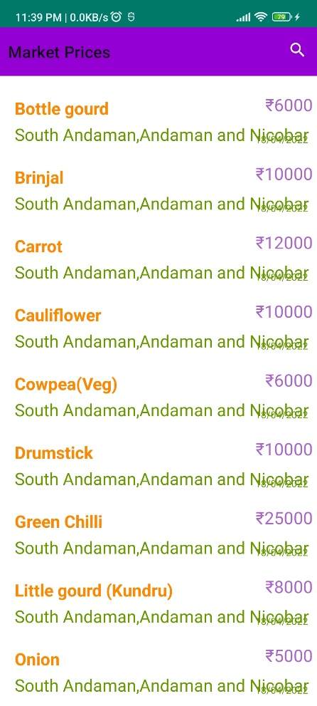
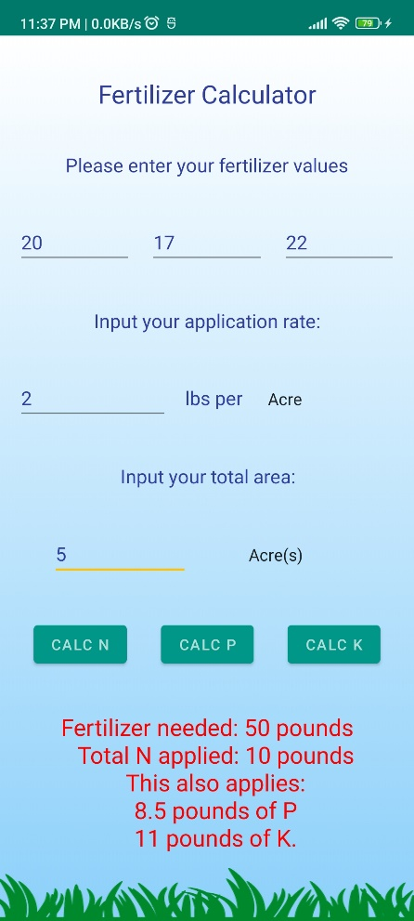
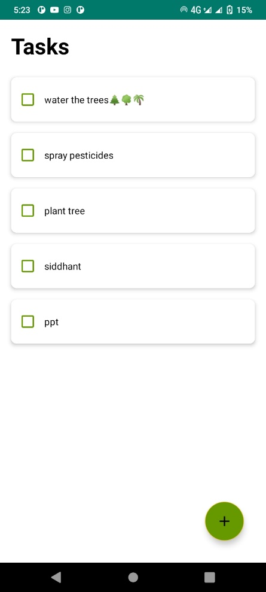

Slide 16
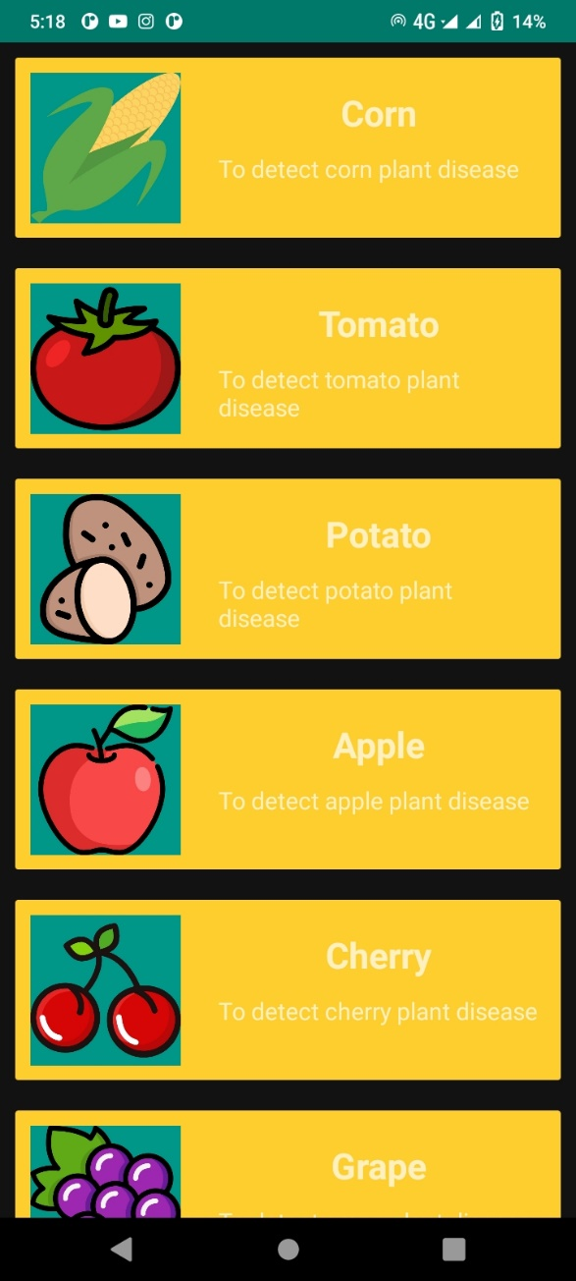
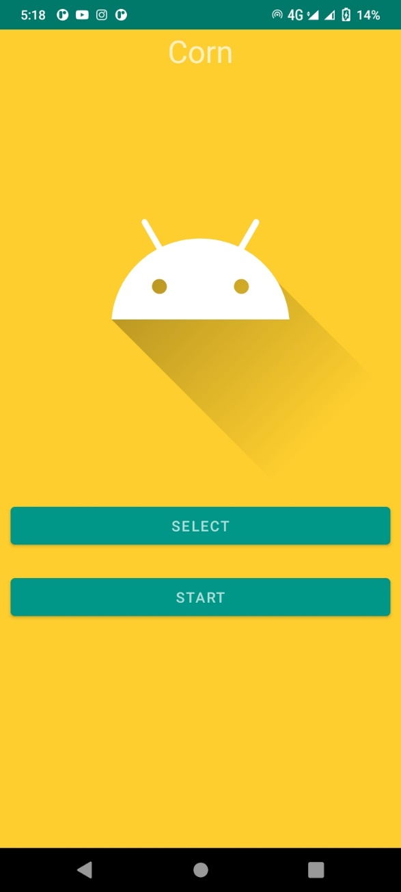
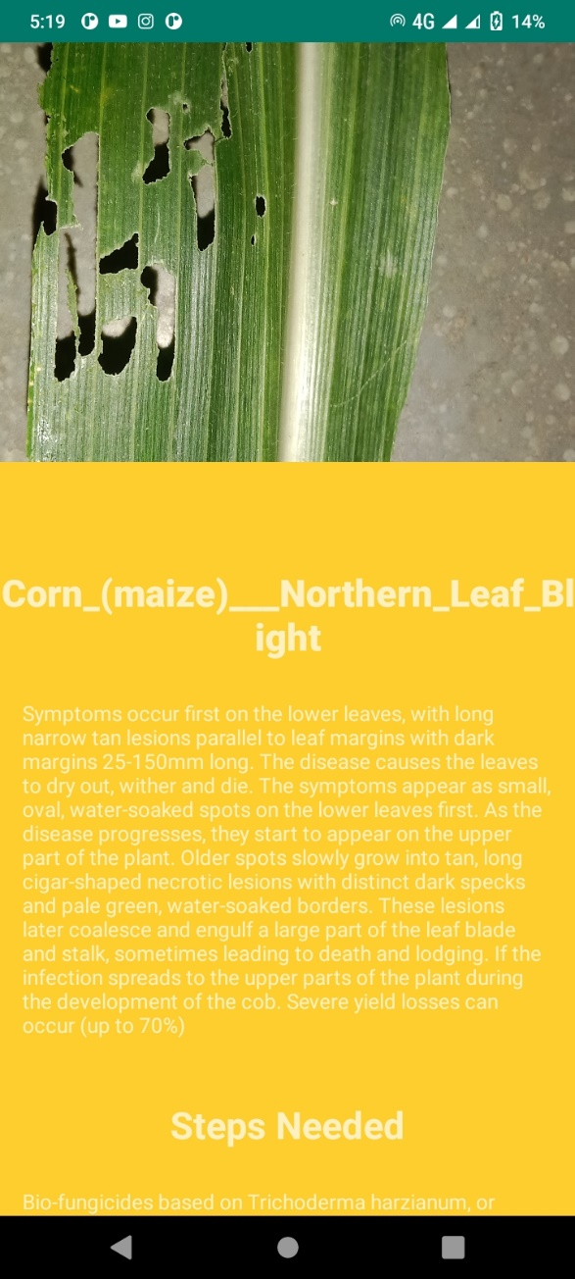

Slide 17
Modules or proposed system
🠶 Inception V3
This is module containing our algorithm for image processing.
🠶 Mobile Application
This module is the front end of project residing on the client side.
🠶 Other modules:
Weather detection, market prices, daily news, fertilizer calculator, to do-tasks

Slide 18
System Requirements
🠶 Software Requirements
Android OS
Android Studio
PyCharm Community Edition 2020.3
JDK, Python 3.8
Python modules-
Tensorflow 1.6.0
NumPy 1.19.2
🠶 Hardware Requirements
Android smart phone with internet connection
PC with minimum 8 GB RAM.
Processor : AMD Ryzen 5 2500U 2.00 GHz

Slide 19
Advantages and Limitations
🠶Advantages
Solution about detected pests.
Time Saving
Daily weather updates
Agriculture Related News
🠶 Limitations
Images captured by farmers should be clear proper light source.

Slide 20
Conclusion
🠶 Image processing technique plays an important role in the detection of the pests. We propose a novel approach for early detection of pests. Our goal is to detect the pests as early as possible and reduce the use of pesticides.

Slide 21
Future Scope
🠶 More features can be added further to analyse the growth of plant and provide insights to increase gross income of farmer.
🠶 A complete guide of latest farming which will be designed by experts.
🠶 Detailed report of daily market prices of vegetables.

Slide 22
Thank You….

